Slide 1
Restaurant Analysis for Chicago
Identifying and analyzing safe districts and areas for Restaurants

Slide 2
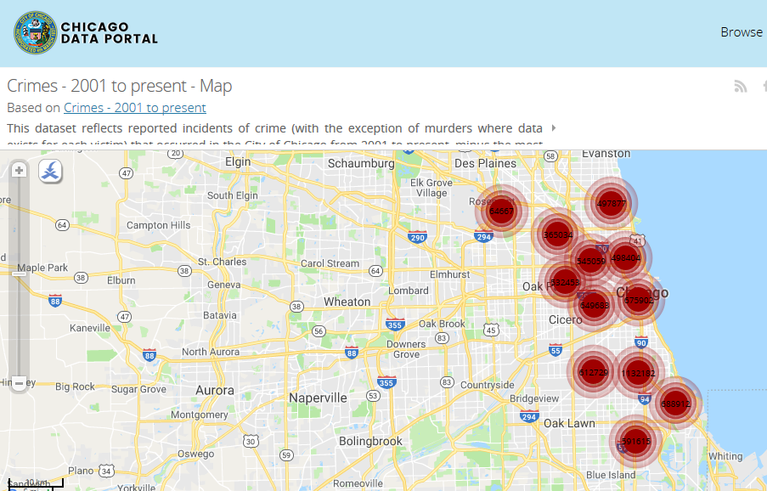
Crime Dataset from Chicago Data Portal

Slide 3
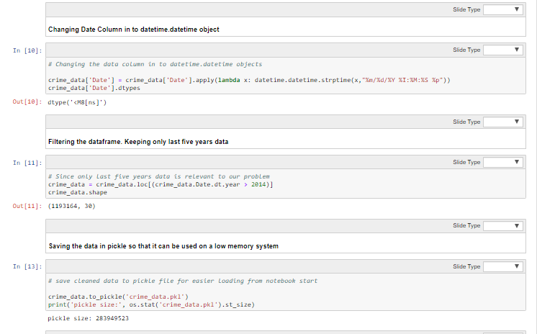
Data Preparation

Slide 4
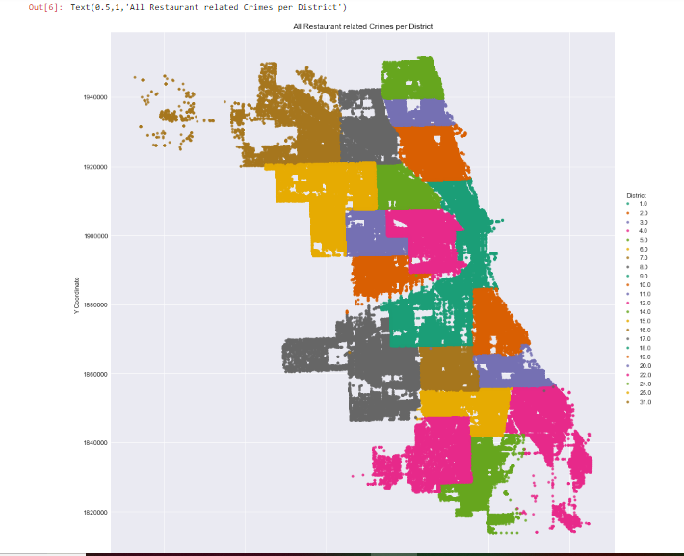
Crimes Affecting Restaurants per District

Slide 5
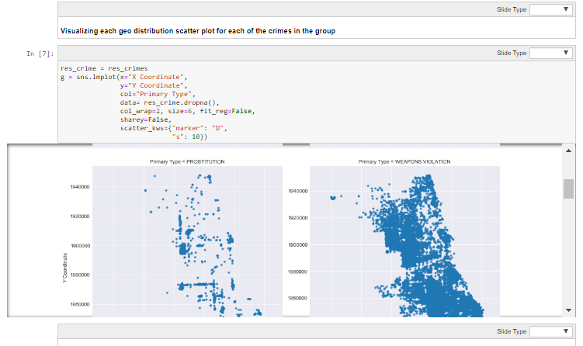
Particular Crimes per District

Slide 6
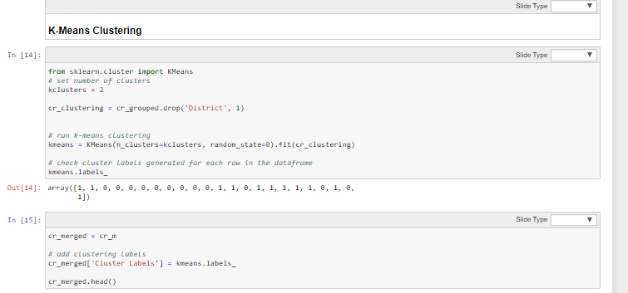
Clustering based on Crime and Location data

Slide 7
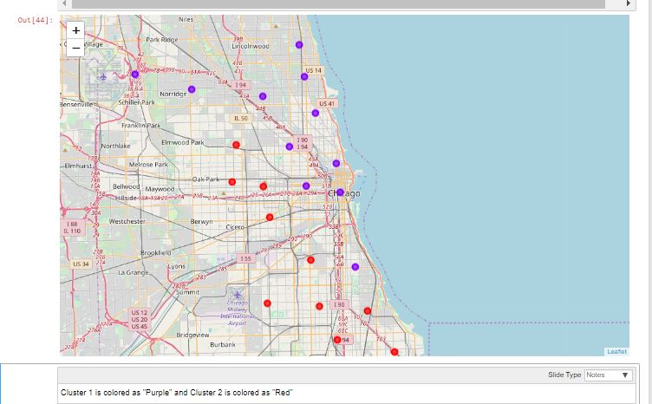
Visualization of Clusters

Slide 8
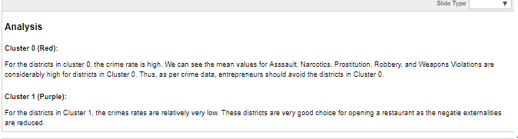
Cluster Analysis

Slide 9
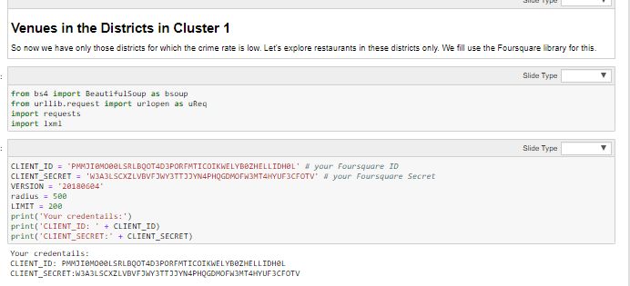
Venue Analysis

Slide 10
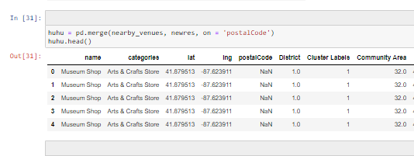
Venues for low crime districts and areas

